Slide 1
GRUBHUB(Food delivery)
Project by :-
palak Agrawal(Team Leader)
asha kumari
sonam jain
Tushar patil
Abhishek Pandey
Arvind s

Slide 2

GRUBHUb InTRODUCTION
Grubhub stands out as a top-tier online platform facilitating food delivery and takeout, effectively linking customers with a wide array of dining establishments.
Renowned for its intuitive interface and expansive network of partnerships, Grubhub has emerged as a key figure in the dynamic realm of food delivery services.
Operating on a commission-driven framework, Grubhub levies a percentage-based charge on restaurants for every order processed via its platform.
Moreover, alongside its delivery provisions, Grubhub extends takeout alternatives and online ordering functionalities to participating restaurants.

Slide 3
OBJECTIVES
Extract data from the Grubhub website pertaining to online food delivery, focusing on various facets such as restaurant information categorized by geographical areas, the range of cuisines available, and ratings.
Analyze the extracted data to derive meaningful insights that can offer valuable perspectives for potential new entrants into the market.
Structure the data extraction process in a manner that facilitates real-time scalability for enhanced accuracy in predictive analytics.
Utilize the insights gained to inform future strategies and opportunities within the online food delivery sector.

Slide 4
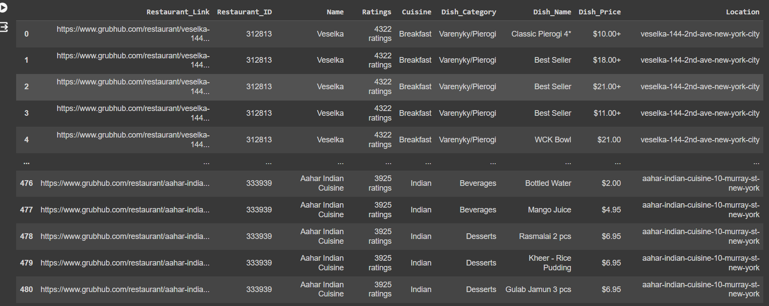
Extracted data
Table : GrubHub Data
restaurant_id : Unique ID to identify the restaurant(Primary Key)
restaurant_link : **Grubhub** URL for that restaurant
name: Name of the restaurant
rating: Rating of the restaurant on**Grubhub**
cusines: What types of cuisine are offered by the restaurant
Dish_category: Dish category
Dish_name : Dish name
Dish_price: Price of the dish

Slide 5

Insights and recommendation

Slide 6
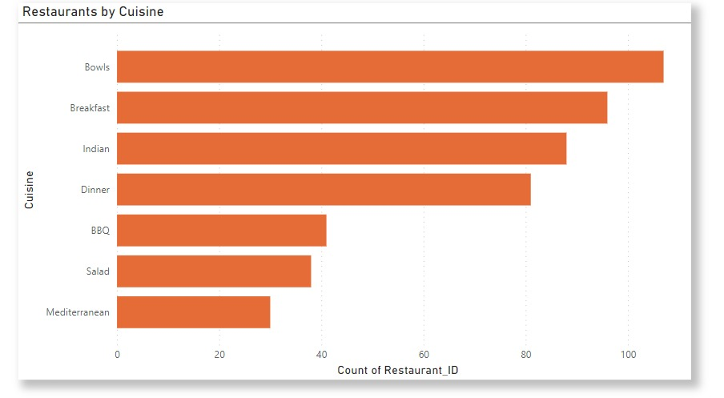
Number of restaurants by cuisine type in New York.

Slide 7
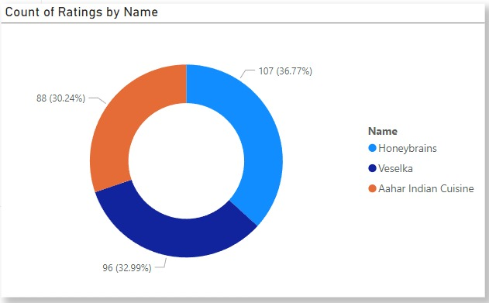
Analysis of Rating Distribution by Name

Slide 8
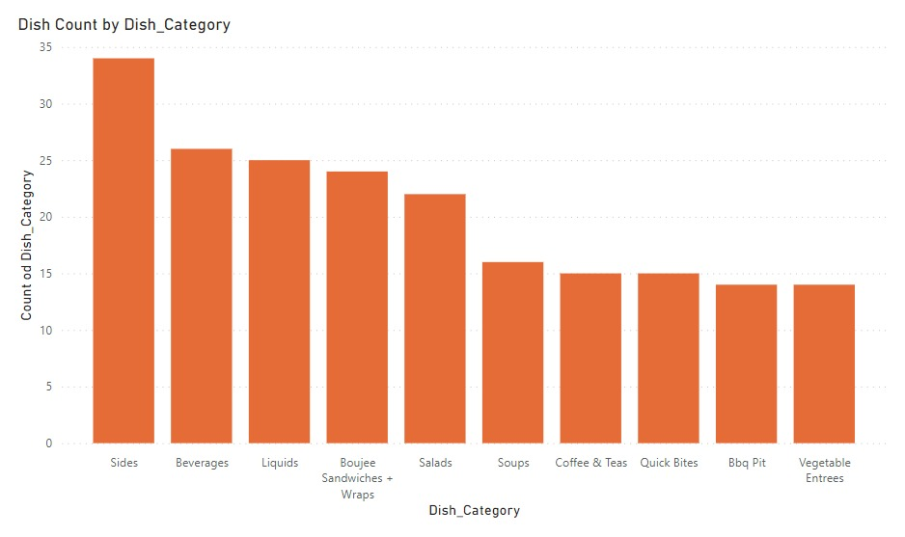
Analyzing Dish Count Across Different Dish Categories

Slide 9
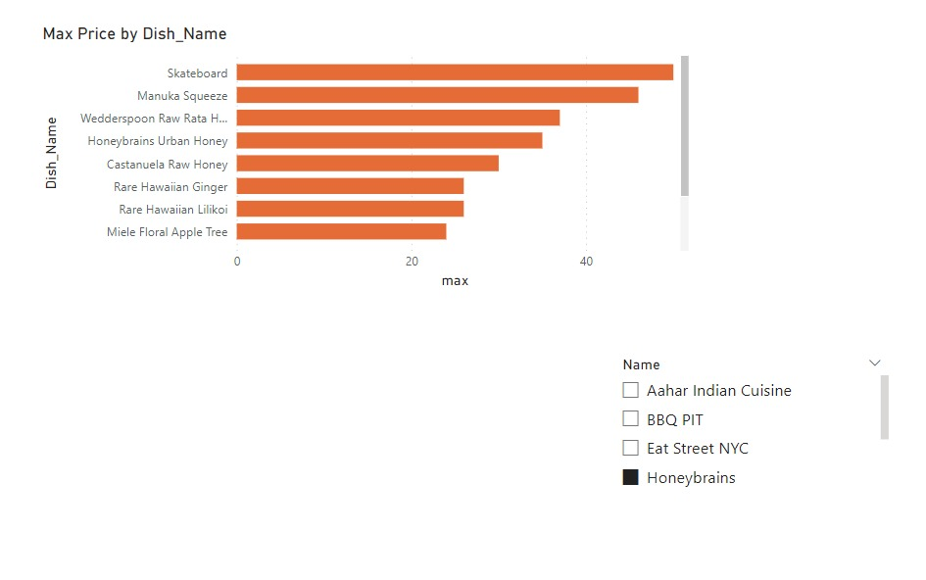
The maximum price per dish based on Dish Names.

Slide 10
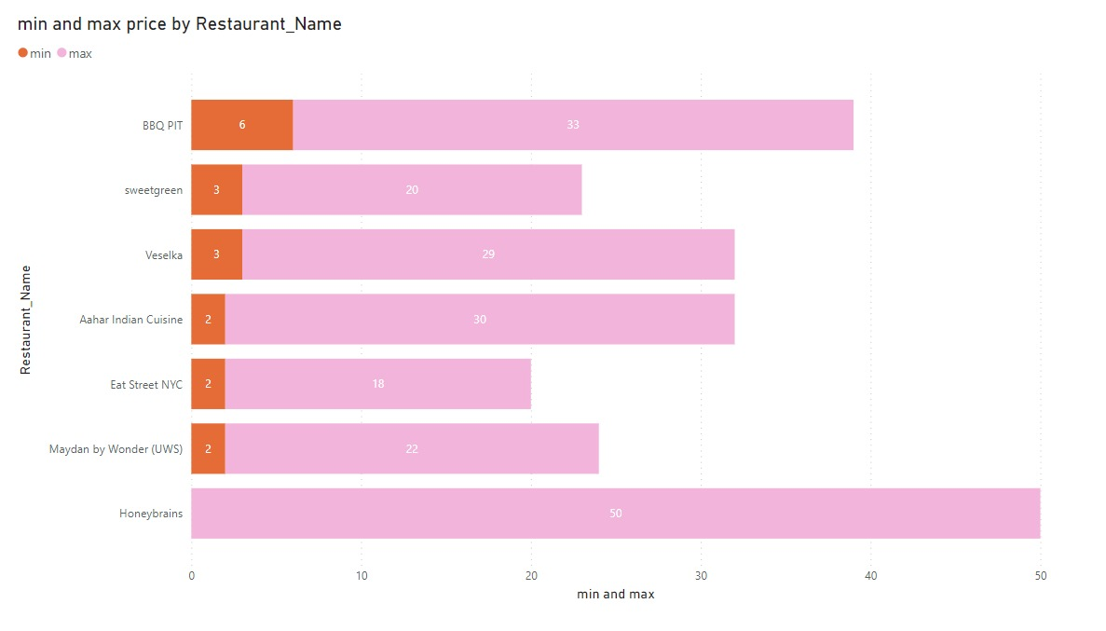
Determining the Minimum and Maximum Prices Across Various Restaurants.

Slide 11
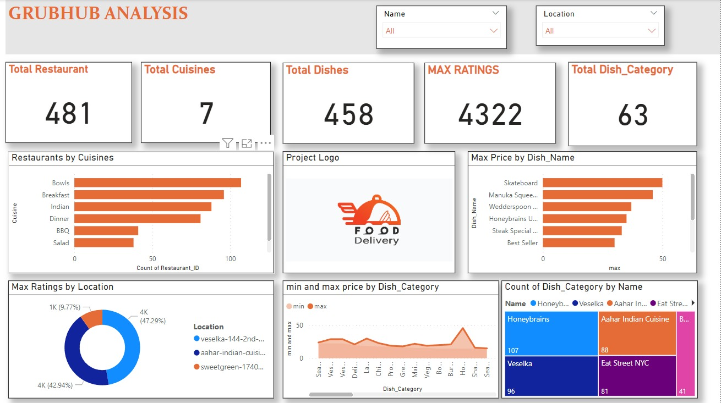
DASHBOARD

Slide 12

Challenges
Dynamicity of Grubhub Website
Data Scrapping
Limited knowledge on HTML
Time Management

Slide 13

Learning Outcomes
Data Scrapping
Effective Time
Management
Python libraries- BeautifulSoup, Selenium
Learned using github

Slide 14
THANK YOU !

